Slide 1
SOCIAL MEDIA
Erin Opar & John Krantz

Slide 2
DRAKE SOCIAL LANDSCAPE
The Challenge
200+ Drake-affiliated accounts
70+ inactive & unrecoverable
Multiple accounts with overlapping audiences/information
Ineffective organic reach (2.2%)
​
The Solution
Channel consolidation efforts
Social media governance & request process
Grow the well-maintained channels with established audiences
Alternative (more effective) ways to reach target audiences
Cross-collaboration between programs, their colleges, and UCM

Slide 3
NEW CHANNEL REQUESTS
The Process
Reach out to Joseph Owens, social media manager
Fill out social media request form with ~12 questions
UCM evaluates and makes recommendations
If approved, UCM sets up and grants access
​
Questions to Ask
Is there a more effective way to reach our intended audiences?
Do I have budget and resources to support its launch and ongoing success? Will they be available in the future?
Is there an already established social channel I can share content through?

Slide 4
SOCIAL MEDIA – A&S / UCM COLLABORATION
A&S social intern
A&S has hired a social media intern, under the guidance of UCM, for the second year.
Last year, the goal of the channel was to grow organically while being a space to promote events and accomplishments across all programs under A&S.
We started the channel from scratch, launching in December, 2023.
​

Slide 5
SOCIAL MEDIA
Student-focused events, news, and achievements, including:
  Shows and performances
  Guest speakers and workshops
  Experiential learning stories
  Unique on- and off-campus J-Term classes
  Student research and awards
  A&S-affiliated clubs or organization spotlights
  Student projects or capstones
Content we're looking for

Slide 6
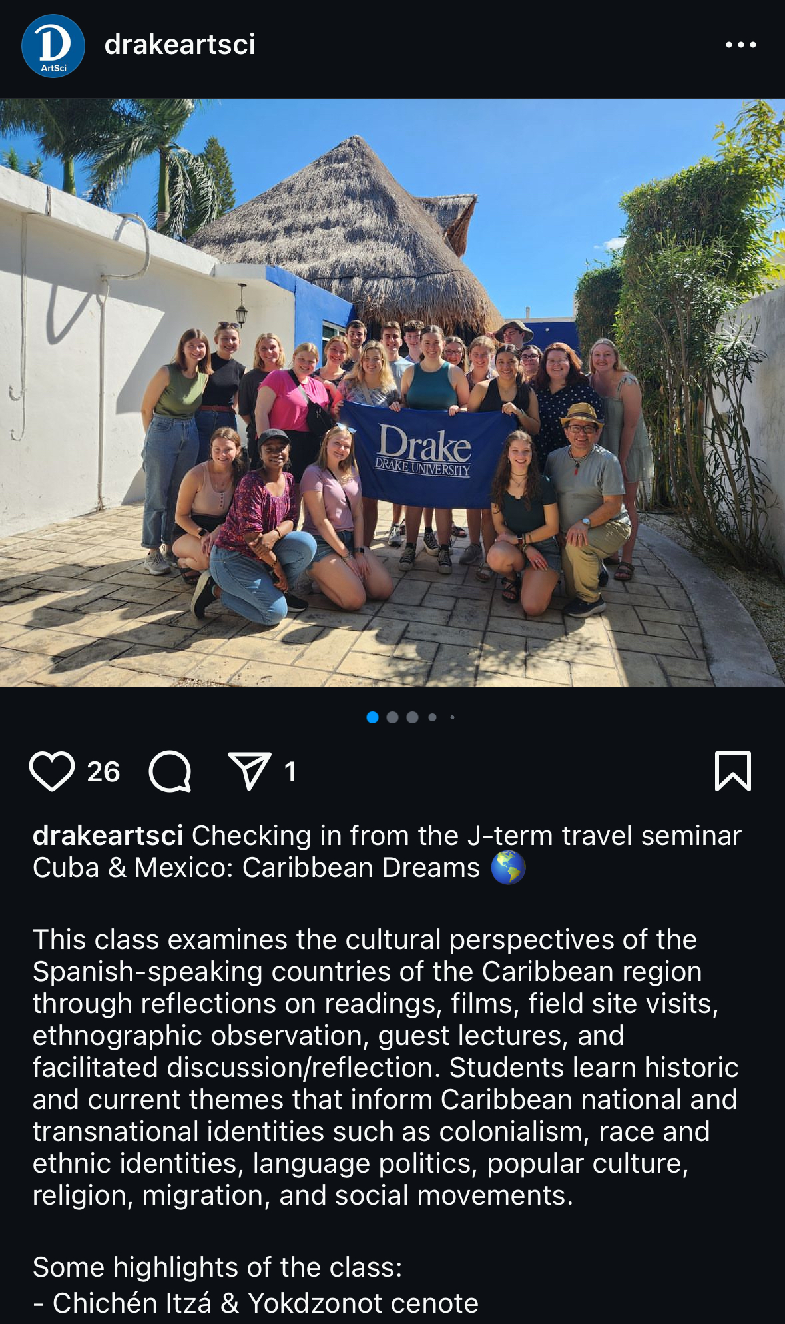
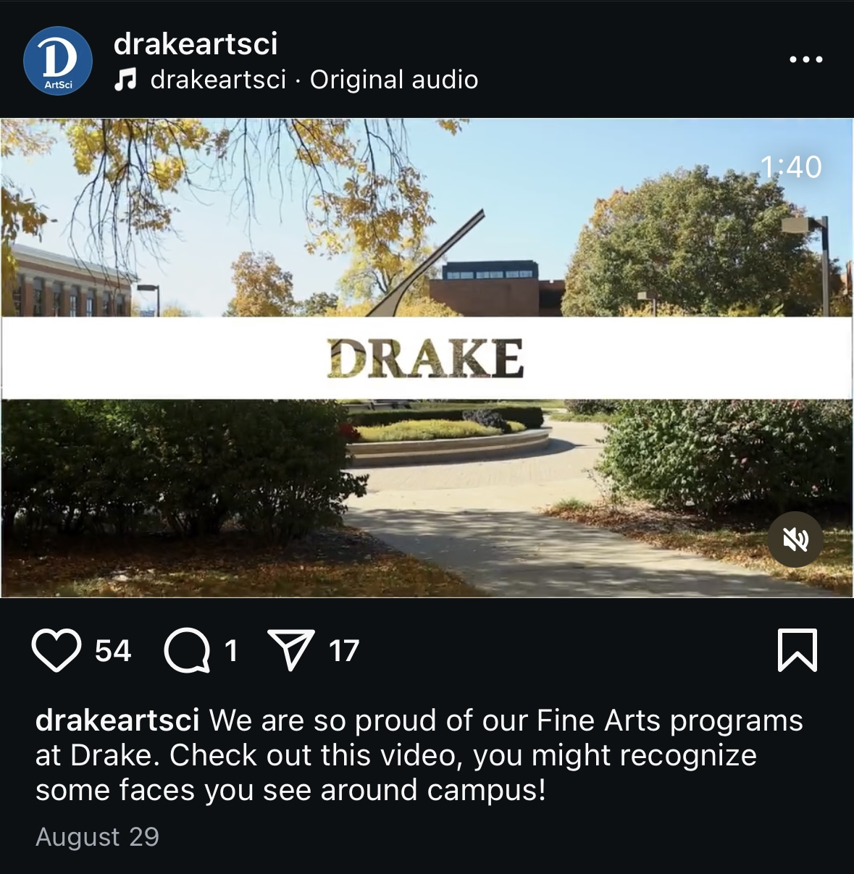
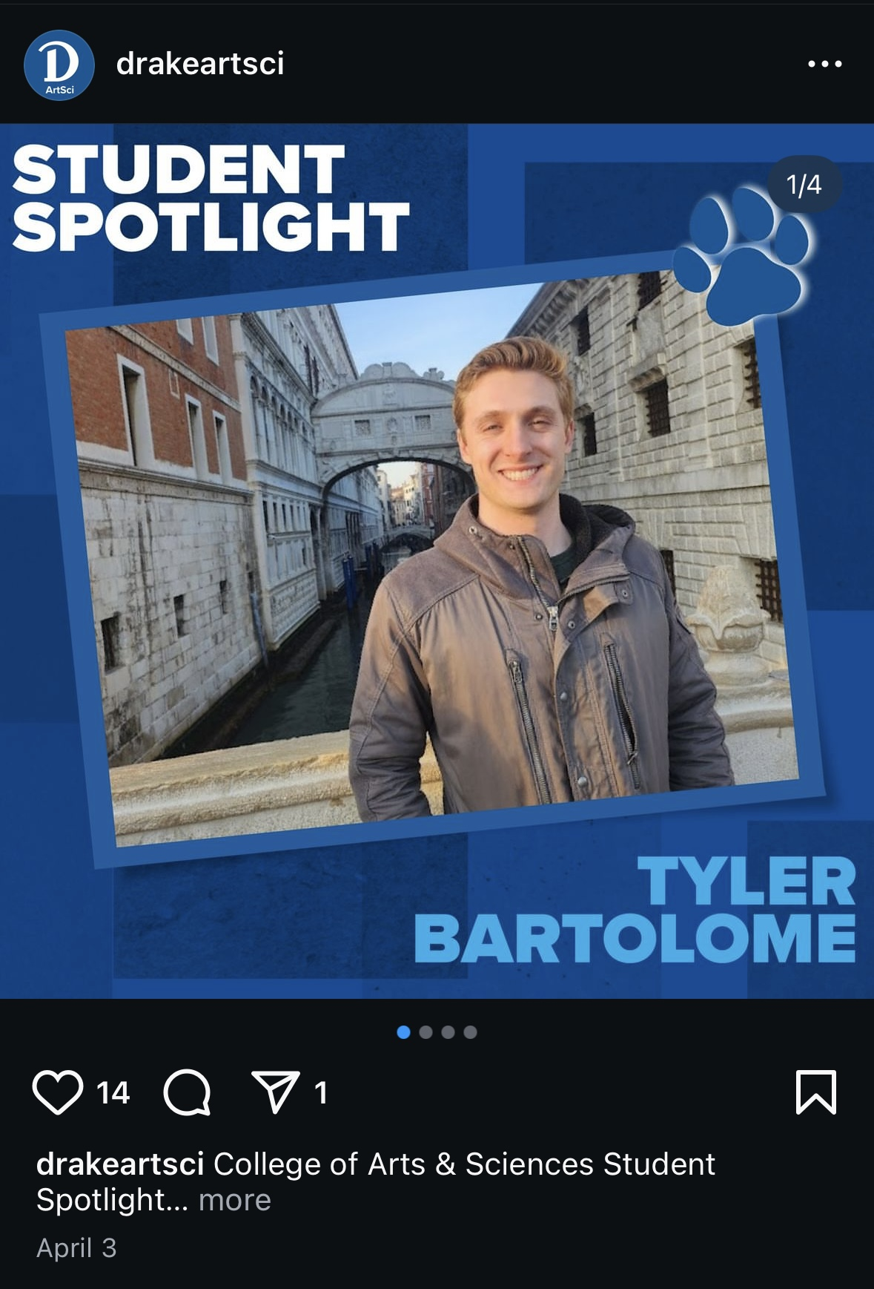
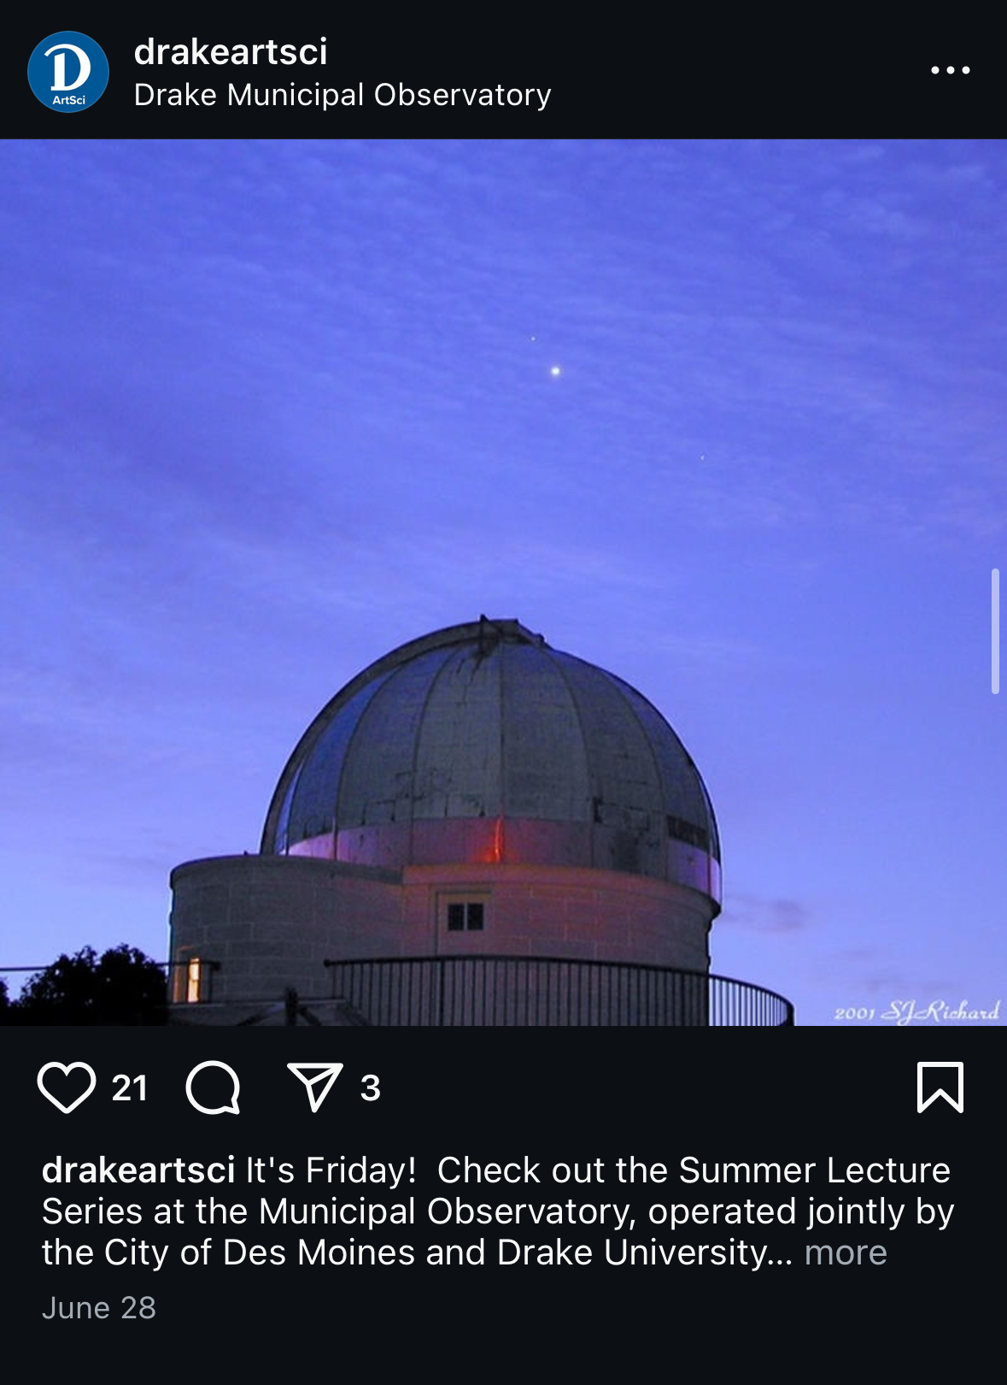
EXAMPLES: A&S SOCIAL CONTENT
Fine Arts Video
Promoting Drake Fine Arts
Spotlights
Showcasing what students and faculty in A&S are up to
Event Promotion
Promotion of on and off campus events
Class Promotion
Highlighting J-Terms or other unique classes

Slide 7
SOCIAL MEDIA
How to submit for the channel
Send background, including student, staff, or faculty names and photos to Jill Allen, who will work with UCM
Our A&S intern will handle the post's caption
UCM and A&S intern determine how best to share

Slide 8
A DEDICATED SPACE FOR PROGRAMS
Facebook & Instagram Highlights
Highlights are collections of Stories that you curate, located at the top of your Instagram profile.
Story Highlights appear directly below your bio and right above the photo grid, so they are one of the first things your followers see.

Slide 9
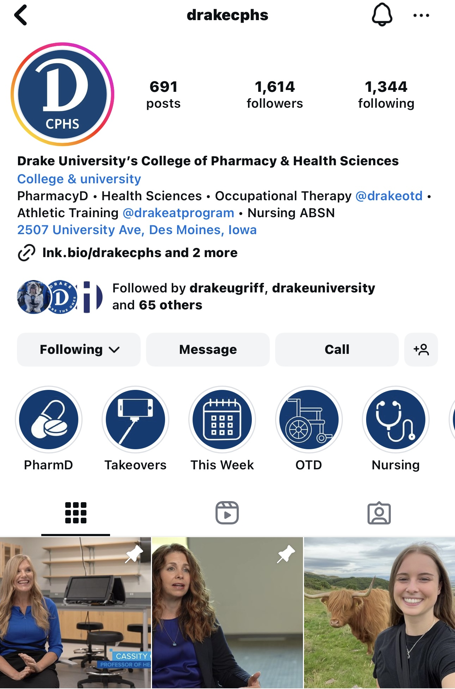
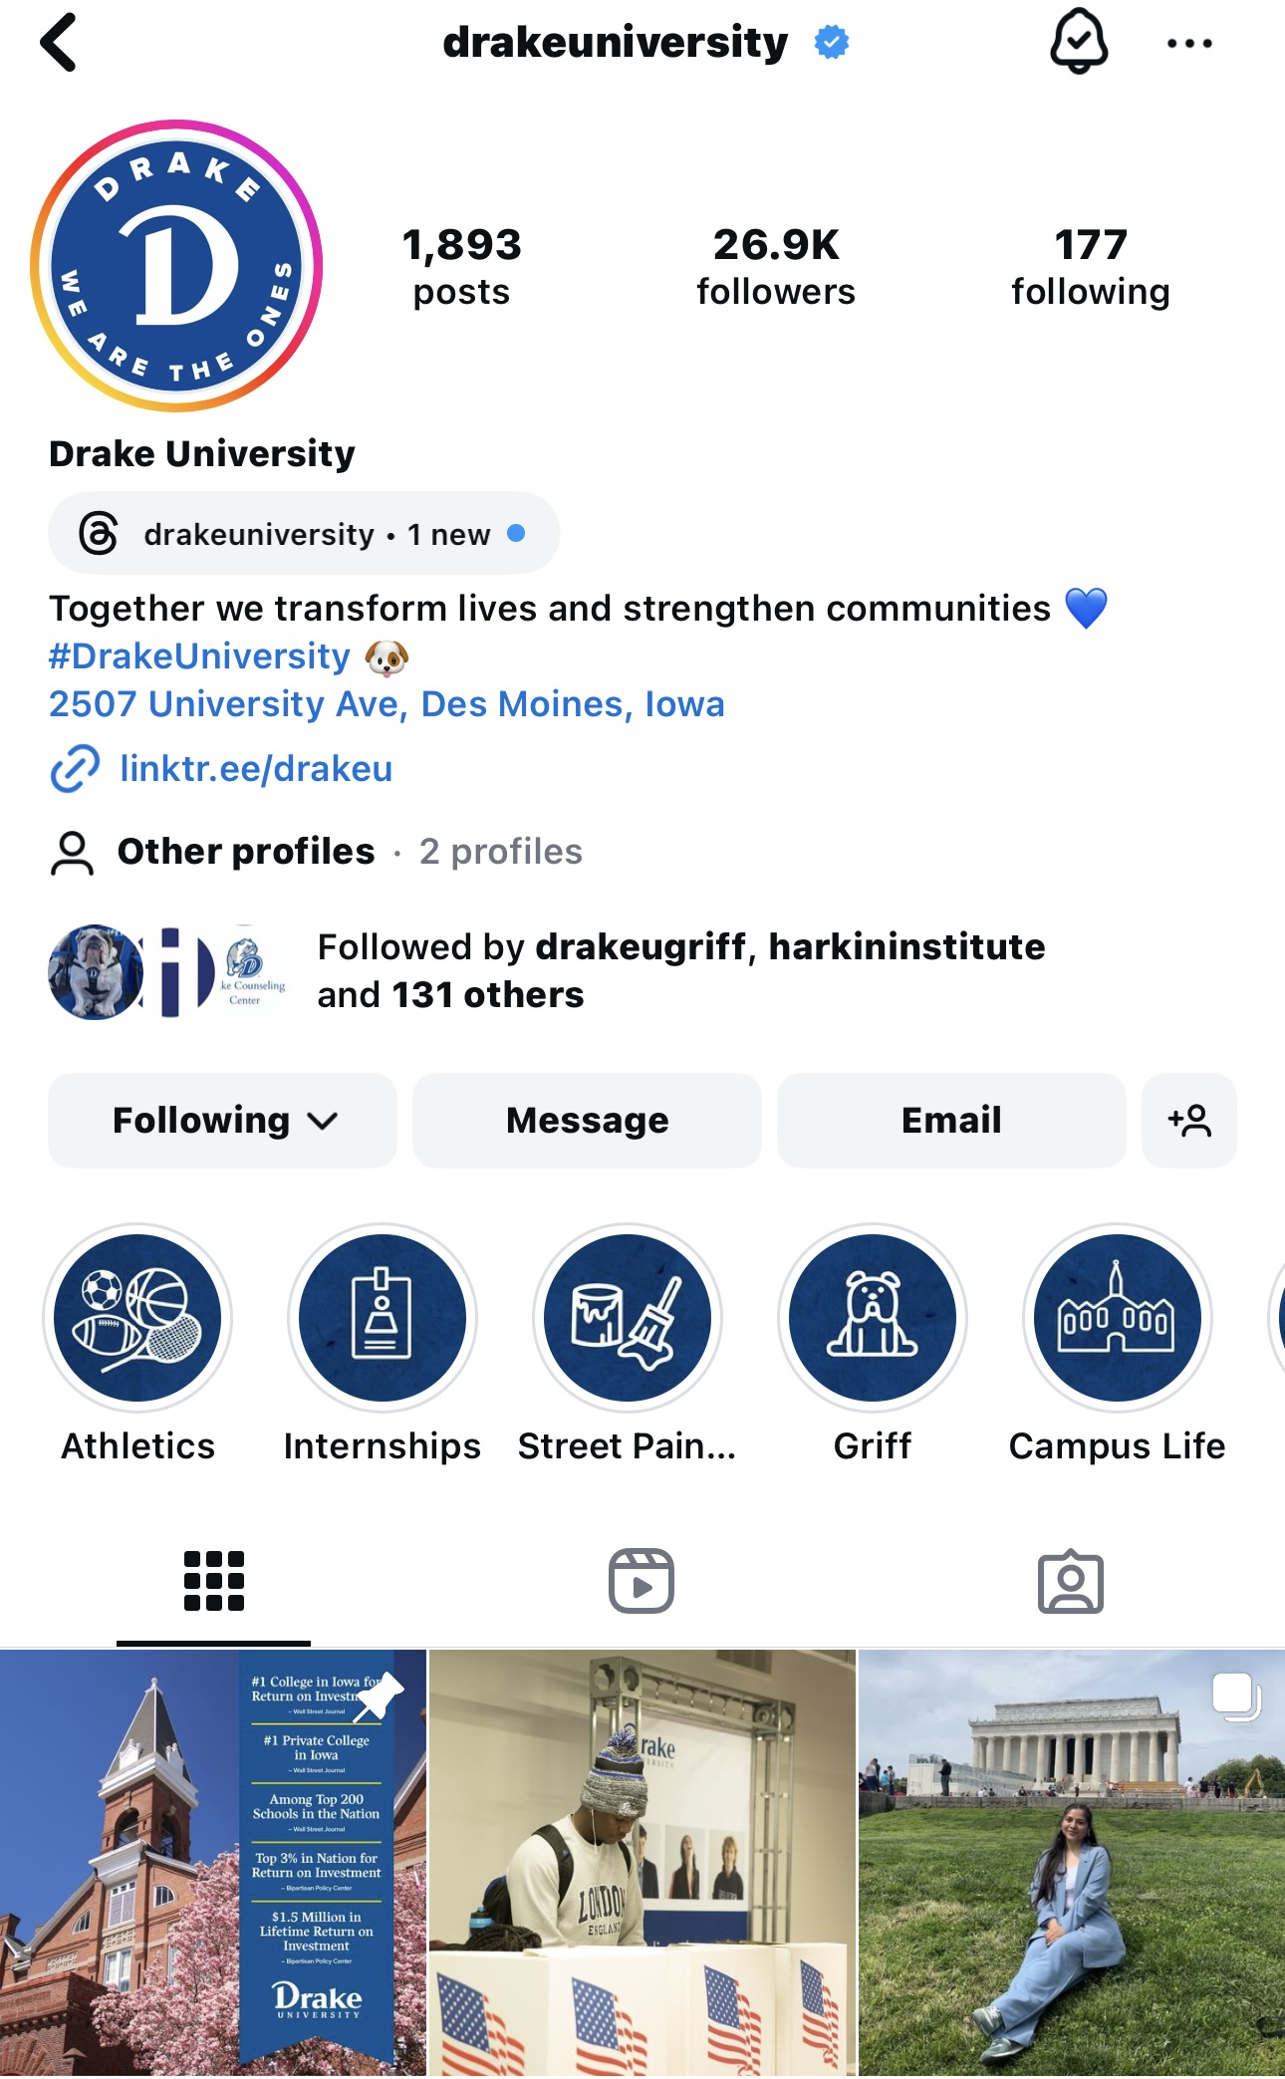
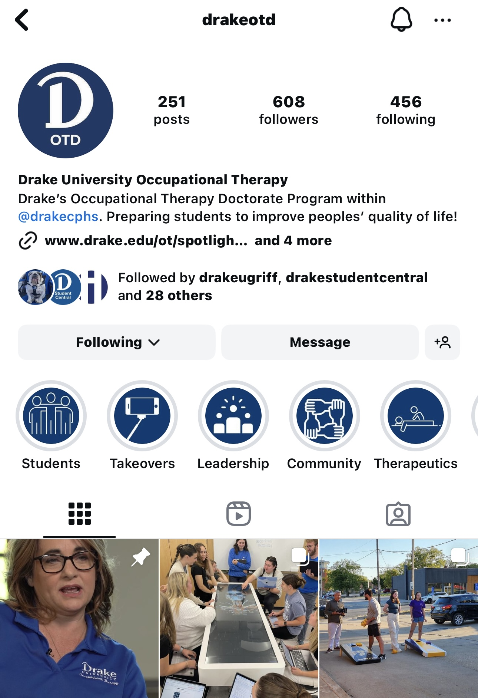
EXAMPLES OF HIGHLIGHTS

